Slide 1
Factors Affecting Student Performance
By Hassan Naik
06/12/2024

Slide 2
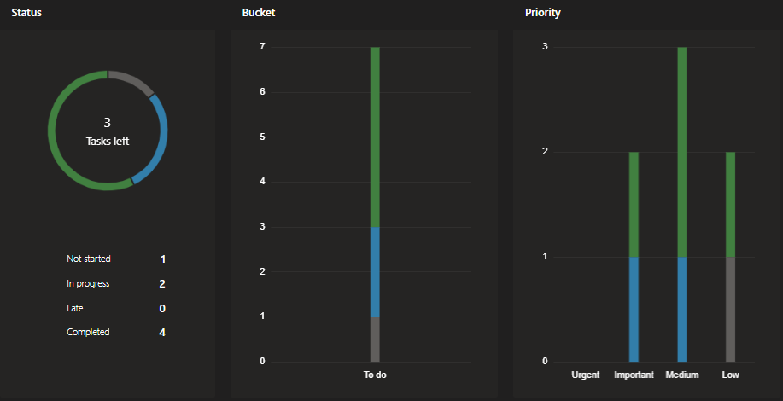
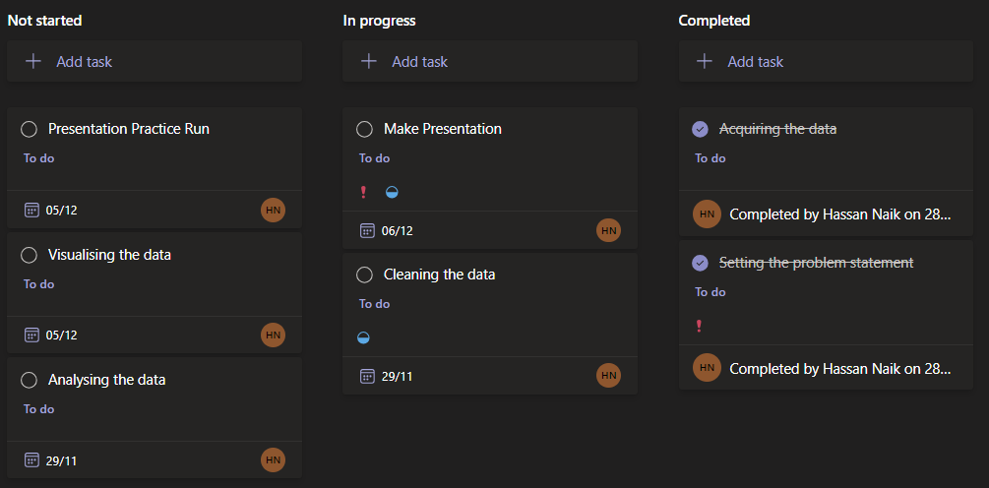
Planning
Notes:
I used teams planner to set my self 7 main tasks to complete with a reasonable time frame and importance

Slide 3

Acquiring the data
I got the Data from Kaggle
https://www.kaggle.com/datasets/lainguyn123/student-performance-factors/data

Slide 4
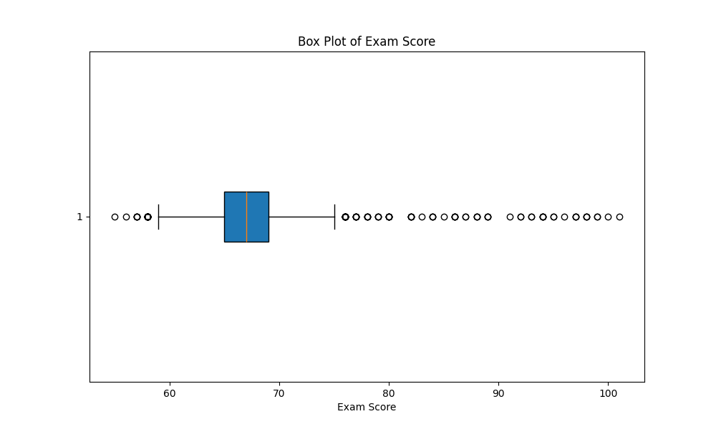
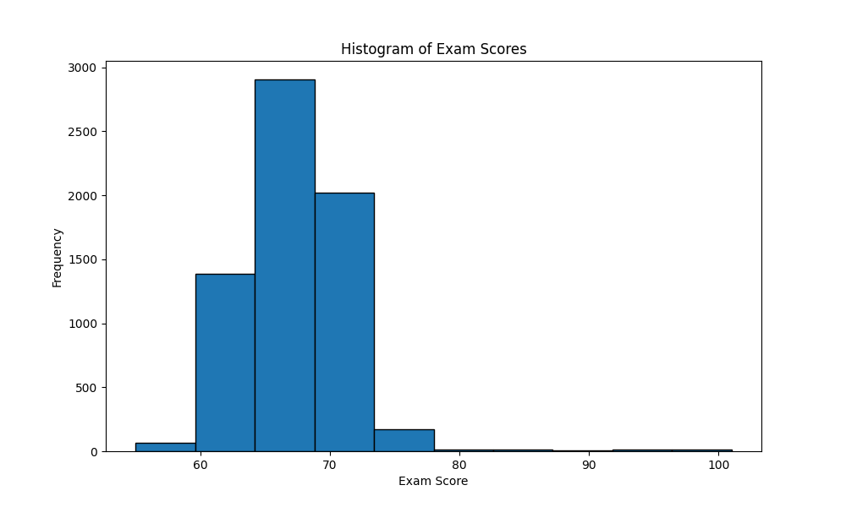
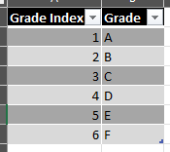
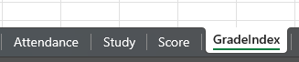

Cleaning the data
https://www.nuffic.nl/en/education-systems/united-kingdom-england-wales-and-northern-ireland/grades-and-study-results
Letter grade | Percentage
A | 70% +
B | 60-69%
C | 50-59%
D | 40-49%
Exam Score
Minimum | 55
First Quartile | 65
Median | 67
Third Quartile | 69
Maximum | 101
Mean | 67.24
Mode | 68
Notes:
I did find some outliers like 101% in exam score
I also created a help

Slide 5
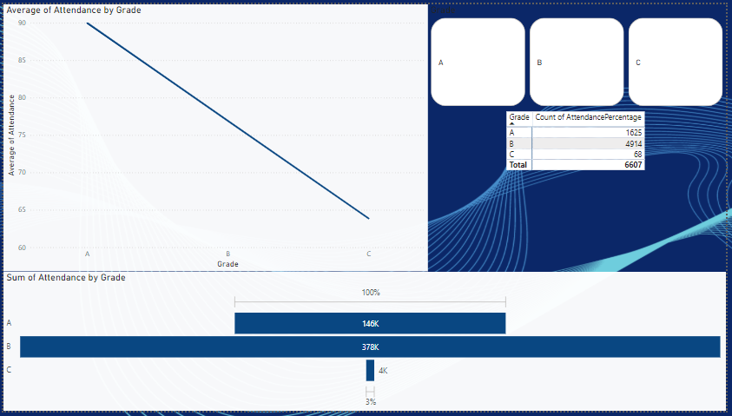

Academic Factor Attendance
Attendance
Minimum | 60
First Quartile | 70
Median | 80
Third Quartile | 90
Maximum | 100
Mean | 79.98
Mode | 67

Slide 6
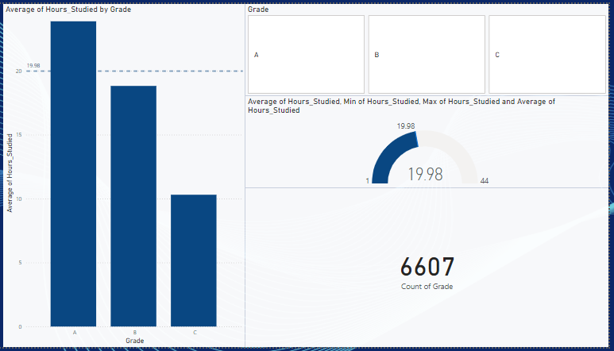
Personal Factor Study Time
Study Time
Minimum | 1
First Quartile | 16
Median | 20
Third Quartile | 24
Maximum | 44
Mean | 19.98
Mode | 20

Slide 7
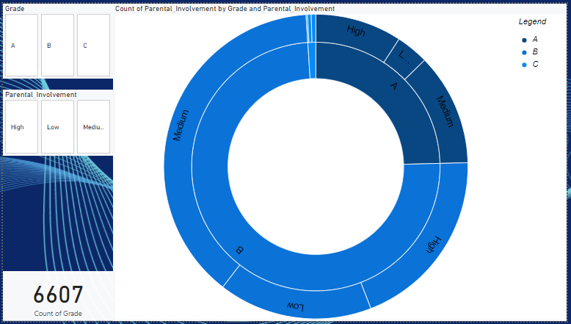
Socio-economic Factor Parental Involvement

Slide 8
Conclusion
There is a positive corelation with study hours and attendance.
As for parent involvement I will have to do further analysis on the education level of a parent to find a corelation between parent involvement and their education level.

Slide 9
further investigation
Technological Factors
Access to Technology
Peer Influence
Peer Support
Peer Pressure
School Environment
Teacher Quality
Notes:
These are some more factors I can look into but I had a time restraint which is why I have not included them

Slide 10
Q&A
Any Questions

Slide 11

https://github.com/HassanNaik/StudentProject
PreformanceFactors - Power BI

